Slide 1
Introduction to the Microbiome

Slide 2
Learning Objectives
Describe the commensurable relationship between humans and microbes, including major location-dependent microbiomes on the human body.
Evaluate the stability and malleability of the microbiome, in relationship to genetic or life-course dependent changes.
Consider the environmental factors that shape the gut microbial niche, and how that affects the kinds of bacterial species that flourish. Use this information to predict how bacteria species may be altered by diet.
Evaluate the role of fiber in providing fuel to the microbiome. Using the physical properties of polysaccharides in fiber, explain why these nutrients are particularly important for microbial function.
Explain the methods by which the microbiome is assessed, including the strengths and weaknesses of each methodology.
Describe the relationship between the gut microbiome and the immune system.
Compare descriptive and interventional studies of microbiota-disease relationships and use this information to consider the strength of the relationship.

Slide 3
Kombucha (a fermented drink) is considered a _________ because it _______
Probiotic because it contains healthy bacteria
Probiotic because it feeds healthy bacteria
Prebiotic because it contains healthy bacteria
Prebiotic because it feeds healthy bacteria
Notes:
A

Slide 4
What statement is false of short chain fatty acids?
They are generated by fermentation of fiber
They are generated by human digestive enzymes in the small intestine
Their production can be altered by changes in diet
They can provide energy to the cells of the gastrointestinal system
Notes:
B

Slide 5
In recent studies, all of the following foods were correlated with increased bacterial diversity except
Dark Chocolate
Red Wine
Whole Milk
Vegetables

Slide 6
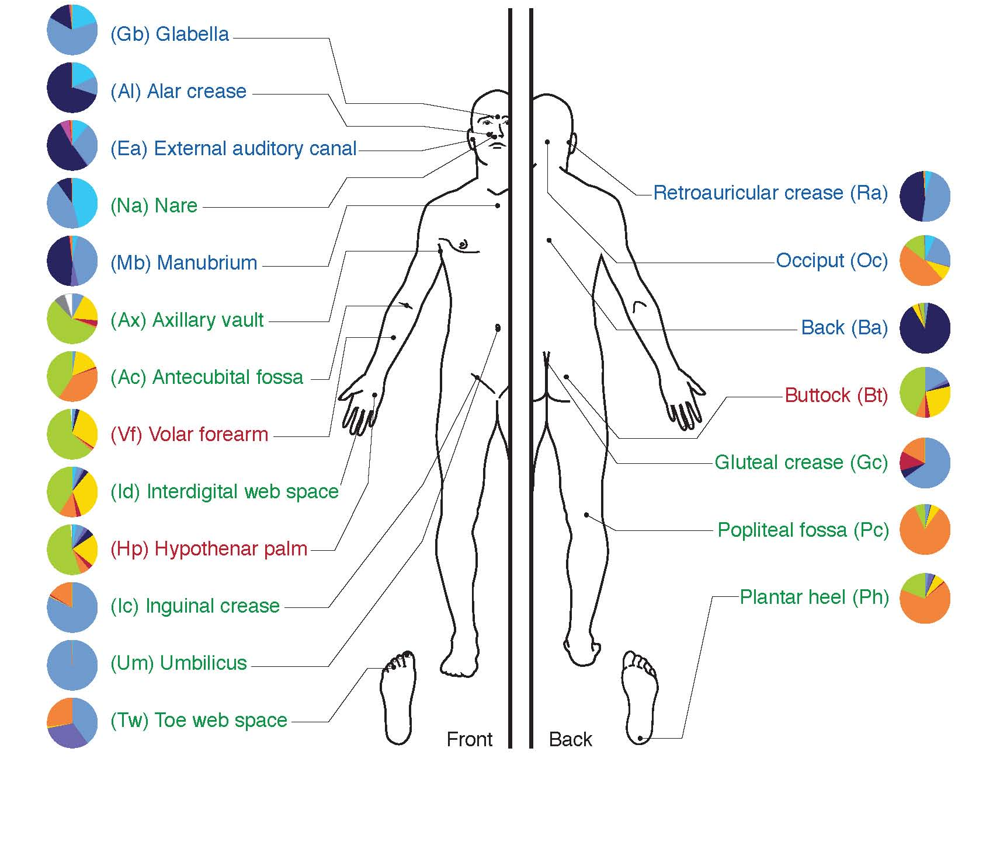
Where are the microbiota on the human body

Slide 7
The Gut Microbiome
Activity
Consider the environment where the highest bacterial load exists
Are these bacteria likely to be aerobic or anaerobic
What sources of food are present?
Predict how some change in diet might affect the kinds of bacteria present

Slide 8
How do we assess the microbiome?

Slide 9
Video
https://www.ted.com/talks/rob_knight_how_our_microbes_make_us_who_we_are

Slide 10
Factors that Modulate the Microbiome
Maternal microbes
Diet
Environmental exposures
Genetics
The host can influence colonization

Slide 11
How can we modify our gut microbial communities
Prebiotics
Selectively fermented ingredient that changes microbial composition and/or activity
Probiotics
Live bacteria meant to colonize
Examples of probiotics:
These include fermented foods like kefir, yogurt with live active cultures, pickled vegetables, tempeh, kombucha tea, kimchi, miso, and sauerkraut.

Slide 12
Minute paper
What is something you learned that you didn’t know before?
What is a question that this brought up in your mind?
What is something that is a bit confusing?
Discuss with your table

Slide 13
Key Roles of the Gut Microbiome
Energy extraction
Development of the gastrointestinal system
Immune barrier function

Slide 14
Microbiomes Differ in Lean and Obese Humans

Slide 15
Can the gut microbiome modify energy extraction?
Ridaura VK, Faith JJ, Rey FE, Cheng J, Duncan AE, Kau AL, Griffin NW, Lombard V, Henrissat B, Bain JR, Muehlbauer MJ, Ilkayeva O, Semenkovich CF, et al. Gut Microbiota from Twins Discordant for Obesity Modulate Metabolism in Mice. Science (80- ). 2013; 341: 1241214–1241214. doi: 10.1126/science.1241214.

Slide 16
What is the form of this energy?
Gas waste
Carbon dioxide (CO₂)
Methane (CH₄)
Hydrogen Gas (H₂)
Hydrogen Sulfide (H₂S)
Short chain fatty acids
Metabolism will be covered in lipid oxidation lecture
SCFA | Used in
Acetate (C2:O) | Blood/Liver
Priopionate (C3:O) | Blood/Liver
Butyrate (C4:0) | Primary Energy Source for Colonocytes

Slide 17
What can we digest, what can bacteria digest?
Humans make α-amylase (α-1,4-glucose linkages)
Some make β-galactosidase (lactase)
Porter, N. T. & Martens, E. C. The Critical Roles of Polysaccharides in Gut Microbial Ecology and Physiology. Annu Rev Microbiol 71, 349–369 (2017).

Slide 18
Microbial Effects on Volumetric Diets
Small pilot study (n=26)
Volumetric diet (3 months)
﻿The nutritional intervention involved a volumetric approach that included larger amounts of fruits, vegetables, and low energy density foods with lesser intake of foods with greater nutrient density.
Mean weight loss was 3.7kg (3.8%)
Evaluated microbiota pre-diet to weight outcomes
Questions to consider:
How do you think the fiber intake changed in the diet?
What metabolic functions of the microbiome before the diet do you think may have been predictive of poor weight loss?
How do you think the microbiome may have changed over the course of three months

Slide 19
Microbial Predictors of Poor Weight Loss
Bacteria with more enzymes of carbohydrate metabolism predicted lack of success in weight loss

Slide 20
Other bacterial metabolites
Choline and carnitine metabolism
Bile salt conjugates (CA/CDCA/TBMCA)
Vitamin K/B12 synthesis
Can act as signals to tissues such as brain and liver.
SCFA Fatty Acid Receptors (GPR41/43)
Bile Acid Receptors (FXR and TGR5)

Slide 21
Two downsides of having excess digestion in the colon
Solutes in the colon retain water
diarrhea
Microbes that produce excessive gas
flatulence

Slide 22
Microbes and flatulence
Endogenous gas
largely in colon, from fermentation:
Raffinose (Gal-Glu-Fru)
Beans, cabbage, brussel sprouts, asparagus
Stachyose (Gal-Gal-Glu-Fru)
Green beans, soybeans, beets, sweet potatoes
Verbascose (Gal-Gal-Gal-Glu-Fru)
Legumes
Lactose (Gal-Glu)
for those who are lactose intolerant)
Why would beano reduce gas formation?
Notes:
For example, need a-Galactosidase to digest the first three and b-Galactosidase to digest the last two

Slide 23
FODMAPS
Fermentable Oligosaccharides
Fructans (like inulin or levan)
Polyfructose with glucose at reducing end
Galactans
Polygalactose
Disaccharides
Mainly lactose
Monosaccharides and
Mainly fructose
Polyols
Sorbitol, mannitol, polyols (some fruits and sweeteners)
Galactan
Inulin – a Fructan
(β-2,1-polyfructose, with a glucose at reducing end)

Slide 24
Review Question
Why might someone be sensitive to fructans?
For some individuals, fructans are undigestable by alpha amylase
Fructans bind water and are retained in the stomach
In some individuals fructans may be digested slowly in the large intestine
Fructans are degraded to fructose in the small intestine, which is poorly absorbed and ends up in the large intestine
Notes:
C

Slide 25
High and Low FODMAP Foods

Slide 26
Barrier Functions and Colon Health

Slide 27
Mucous Membranes are Protective Barriers Made of Polysaccharides Produced by Gut Cells

Slide 28
Endogenous Glycans As Bacterial Energy Source
Desai, M. S. S. et al. A Dietary Fiber-Deprived Gut Microbiota Degrades the Colonic Mucus Barrier and Enhances Pathogen Susceptibility. Cell 167, 1339–1353.e21 (2016).
Notes:
When the bacteria run out of good food, they start degrading the polysaccharides in the mucus layer, this makes the cells more prone to pathogenic infections and epithelial cell damage.

Slide 29
Immune Function and Gastrointestinal development.
Katherine Boss
NUTR 630
Sept 24, 2018

Slide 30
Immune system basics
Innate
Adaptive
General defense
Acts Quicker than Adaptive
Nonspecific
Examples:
skin
mucous membranes
unspecific inflammatory reaction
Takes longer to set in (4-7 days)
Specifically attacks pathogens/foreign particles
More accurately targets pathogens
Has memory
Antibodies
Interact with antigens produced by pathogens
Notes:
Innate immune system:
The innate immune system is the body’s first defense again potential pathogens. It includes the skin, mucous membranes, and white blood cells (leukocytes). These work together to work to fight off initial infections. Now, because its fast acting, its not specific. It simply sees something as “not self” (ie a protein or the entire bacteria is recognized by some immune cell and doesn’t have a self-marker on it) and is destroyed. This works really well for the most part and helps keep us healthy.
Adaptive Immune system:
The adaptive immune system takes a lot longer to begin, however, this system has memory ( called B-cells ) which are able to “recognize” the proteins as an infection your body has previously overcome. Because of this, it more accurately targets pathogens by using antibodies. Antibodies are those classic Y shaped proteins you see when talking about the immune system. These are able to mark the pathogen for destruction and keep it from hurting your cells. It also allows your body to mount an even quicker response if you see this same pathogen again.

Slide 31
Microbes and development of the GI system
Interactions between our epithelia cells and microbes
MAMPS (Microbe associated molecular patterns)
Creation of barrier in gut
Differentiation between good and bad bacteria
AMPS (antimicrobial peptides)
Produced by epithelial cells
Part of the innate immune system
Cerf-Bensussan, Nadine, and Valérie Gaboriau-Routhiau. “The Immune System and the Gut Microbiota: Friends or Foes?” Nature Reviews Immunology, vol. 10, no. 10, Sept. 2010, pp. 735–744., doi:10.1038/nri2850.
Notes:
Colonization begins shortly after birth in humans and actually reaches a pretty high density quickly. It is speculated that our relationship with microbes in our gut have evolved into a necessary relationship that is mutually beneficial for nutrient absorption and is involved in mechanisms to protect the host and help maintain intestinal homeostasis in both the innate and adaptive immune system.
One kind of interaction is through MAMPS. MAMPS: necessary proteins/structures that are recognized by receptors on the surface of our epithelial cells in the gut. Through this bidirectional communication between our cells and the microbes, our immune system has evolved to recognize these microbes as “okay” and that it shouldn't begin an immune response. They do this through changing expression of antimicrobial peptides (AMPs). These effectors modulate acquired immunity in the host through their ability to regulate the composition of the intestinal microbiota by using the barrier that we have talked about in class already.
This cross talk between MAMPs and AMPs are important because it keeps bacteria from translocation (or jumping around) the intestinal lining while also keeping pro-inflammatory signals limited keeping the innate immune system in check. Because of this, it allows a delicate balance of microbial life and immune system activity that is integral to our health.

Slide 32
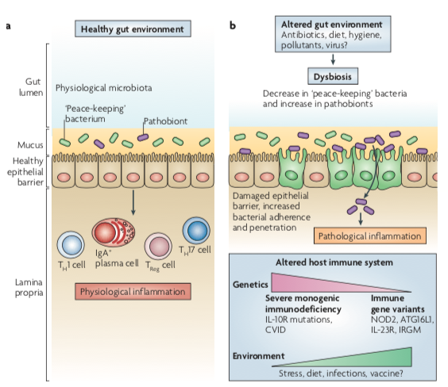
Inflammation can result from loss of barrier function
Barrier loss →
immune system balance thrown off →
destruction of “good” bacteria & overgrowth of “bad”/more pathogenic bacteria →
disease
Cerf-Bensussan, Nadine, and Valérie Gaboriau-Routhiau. “The Immune System and the Gut Microbiota: Friends or Foes?” Nature Reviews Immunology, vol. 10, no. 10, Sept. 2010, pp. 735–744., doi:10.1038/nri2850.
Notes:
Reference diet lacking fiber that causes breakdown of the barrier so cells begin to interact with bacteria and potential pathogens can invade host cells
Since the barrier is compromised, it disrupts the delicate balance of the MAMPs, AMPs, and general immune response. This can simultaneously cause suppression of the healthy microbial gut flora and allow pathogenic bacteria to gain direct contact with epithelial cells. From there they are able to get into the cells and cause infection. As seen in the figure, the pathogens, as they enter the epithelia cells causing cellular destruction, can cause inflammation through microbial adherence to epithelial cells, epithelial damage, and increased entry though epithelial cells into intestinal tissue, all of which can cause symptoms like those seen in IBD.
Another issue is that this process is seen to have favored the more intense pathogens that can better survive the host’s immune system allowing their population to grow and potentially cause serious disease in immunocompromised individuals.

Slide 33
References
Round, June L., and Sarkis K. Mazmanian. “Erratum: The Gut Microbiota Shapes Intestinal Immune Responses during Health and Disease.” Nature Reviews Immunology, vol. 9, no. 8, 2009, pp. 600–600., doi:10.1038/nri2614.
“The Innate and Adaptive Immune Systems.” Current Neurology and Neuroscience Reports., U.S. National Library of Medicine, 4 Aug. 2016, www.ncbi.nlm.nih.gov/pubmedhealth/PMH0072580/.

Slide 34
Immune Function and Gastrointestinal Development

Slide 35
Microbes and Development of the GI System
Epithelial cells respond to bacterial signals
MAMPS (Microbe associated molecular patterns)
Immune system communicates learns which bacteria to support and which to kill:
AMPS (Antimicrobial peptides)

Slide 36
Inflammation can result from loss of barrier function
Inflammatory Bowel Disease (IBD)
Cramps
Diarrhea
Fever
Weight Loss and Loss of Appetite
Blood Loss (anemia)

Slide 37
Human Milk Oligosaccharides
Often our first probiotics
Promotes growth of particular bacterial species that can metabolize these carbohydrates
Vary with genetics/diet/health
Promotes Specific
Bacterial Colonization
GI/Immune
Development
HMO
Lactose at one end

Slide 38
Should Public Policy Encourage Breastfeeding?
Positive Benefits
Negative Consequences
Nutrients not present not in formula or milk
Psychological bonding
Convenient and inexpensive
Sterile source of liquids (important for developing countries)
Can be inconvenient, requires lifestyle modifications
Can be painful
Stressful especially at beginning
Partner cannot breastfeed

Slide 39
Learning Objectives
Describe the commensurable relationship between humans and microbes, including major location-dependent microbiomes on the human body.
Evaluate the stability and malleability of the microbiome, in relationship to genetic or life-course dependent changes.
Consider the environmental factors that shape the gut microbial niche, and how that affects the kinds of bacterial species that flourish. Use this information to predict how bacteria species may be altered by diet.
Evaluate the role of fiber in providing fuel to the microbiome. Using the physical properties of polysaccharides in fiber, explain why these nutrients are particularly important for microbial function.
Explain the methods by which the microbiome is assessed, including the strengths and weaknesses of each methodology.
Describe the relationship between the gut microbiome and the immune system.
Compare descriptive and interventional studies of microbiota-disease relationships and use this information to consider the strength of the relationship.

